Slide 1


Team Number: DC20075
Dataset: Ocean Cleanup
Connor Howard, Christopher Smith, Yixin Ye

Slide 2
Assumptions About Dataset
Each piece of garbage collected was a whole piece
Each person in a group does equal amount of work
Each person only participated in one event

Slide 3
Data Preparation
Dataset is input by any person who has the app, so there is a greater chance for error
Went through and eliminated all outlier data, such as a single person picking up a single piece of trash weighing 10,000 pounds
Gathered 2019 U.S. population estimates from the U.S. Census Bureau

Slide 4
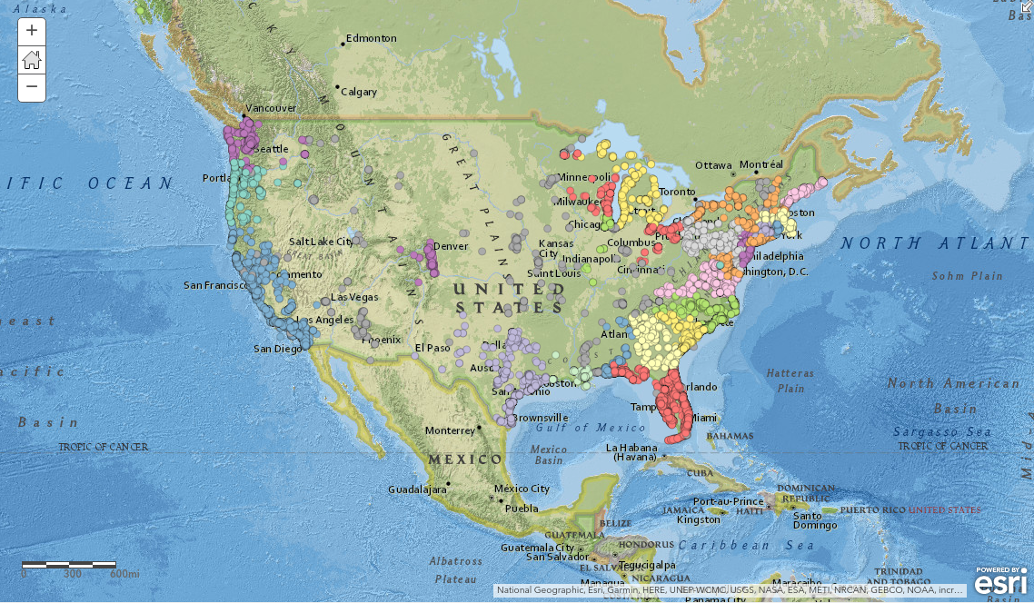
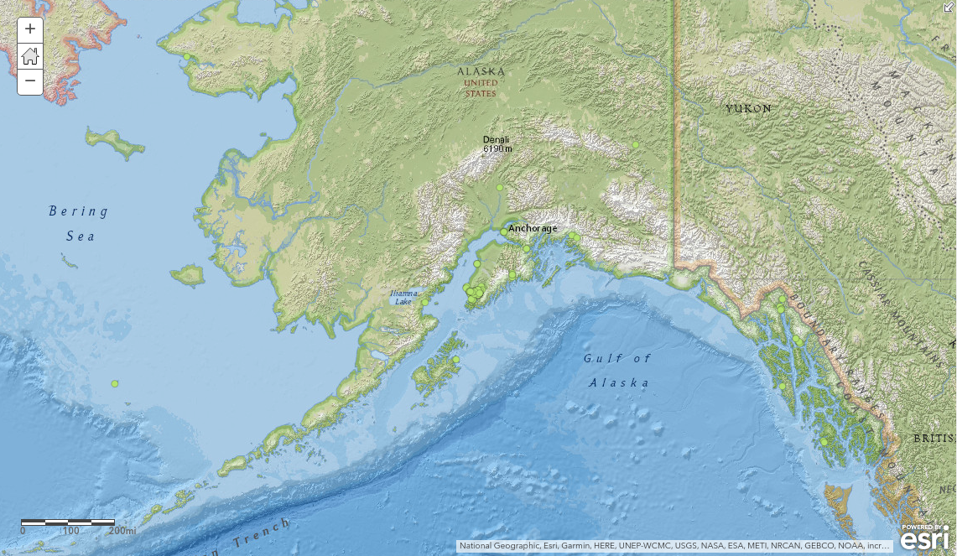
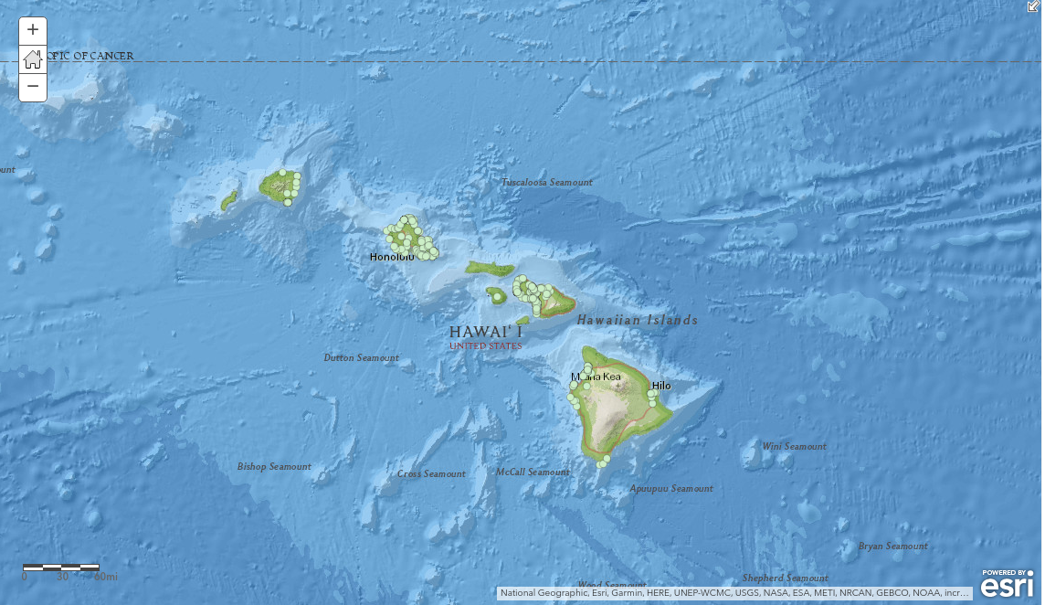
Locations of Trash Cleanups
http://arcg.is/0zOzWC

Slide 5
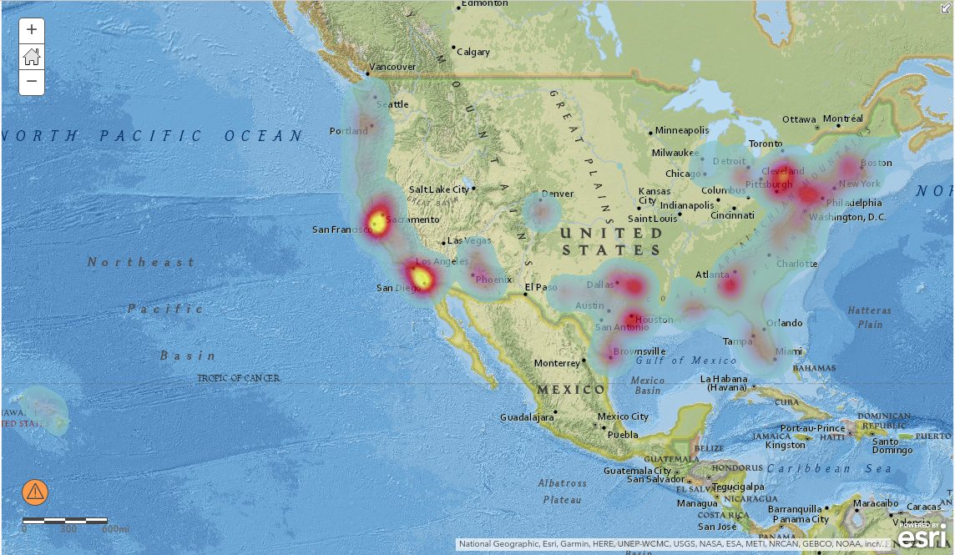
Concentration of Trash by Pounds Collected

Slide 6
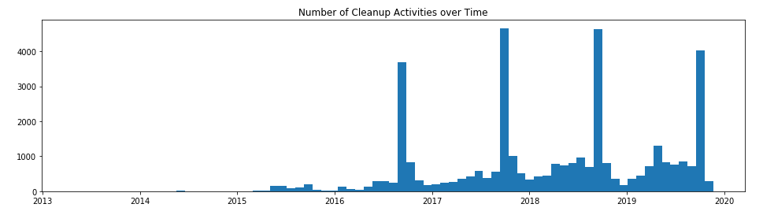
Number of Events by Month

Slide 7
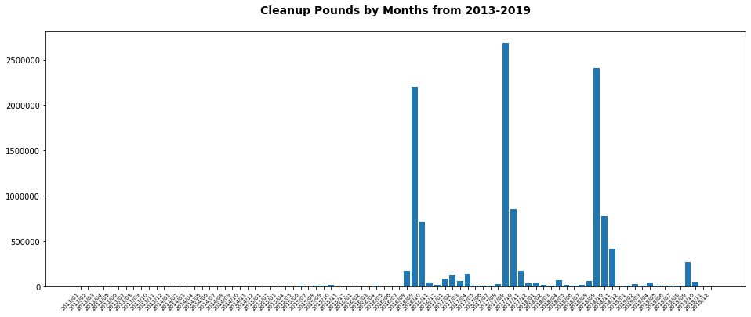
Pounds Per Month

Slide 8
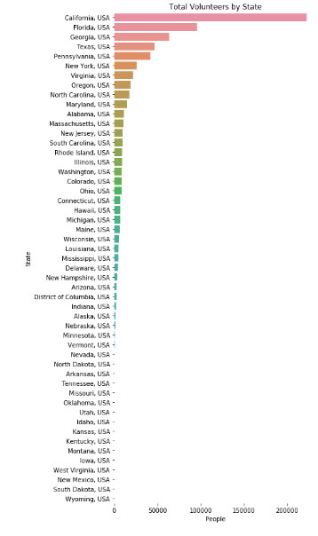
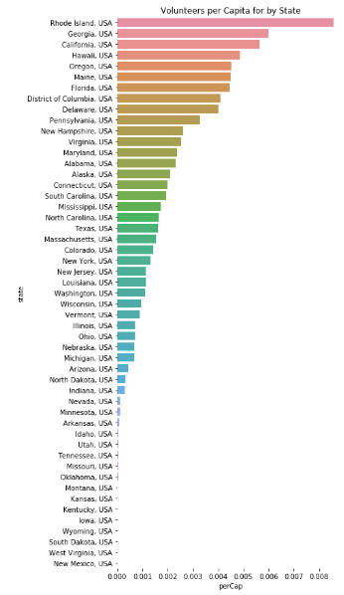
Volunteers by State
State Population taken from 2019 Population Estimates by U.S. Census Bureau

Slide 9
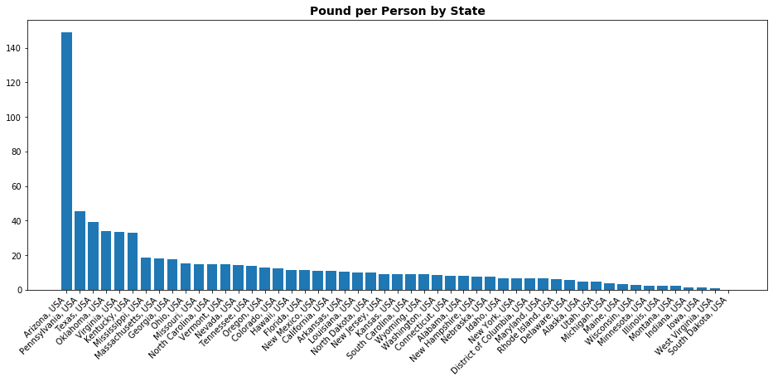
Pounds Per Person for Each State

Slide 10
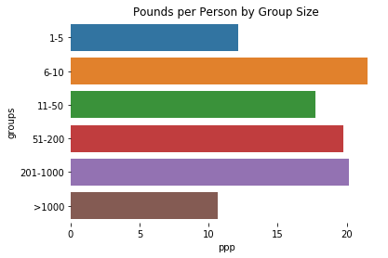
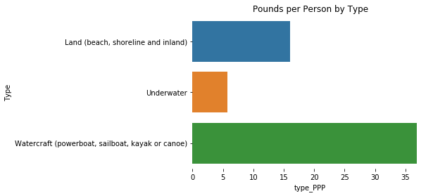
Effective Group Sizes/Cleanup Types
Effectiveness measured by pound per person

Slide 11
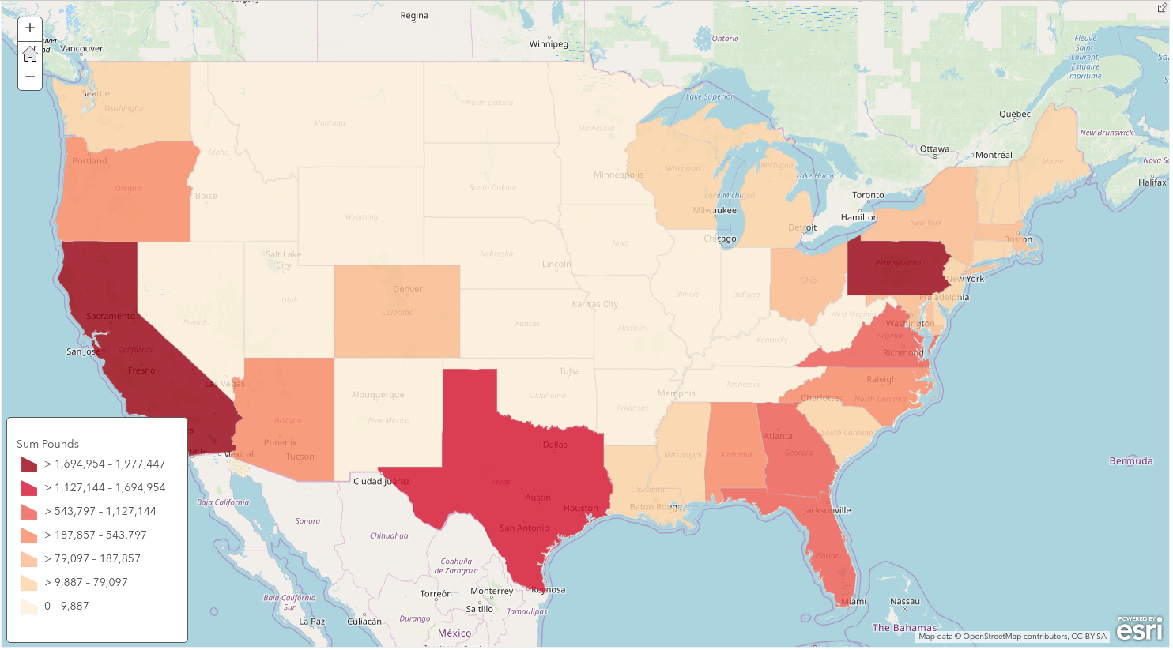
Volume of Garbage Collected by State
http://arcg.is/19GqXC

Slide 12
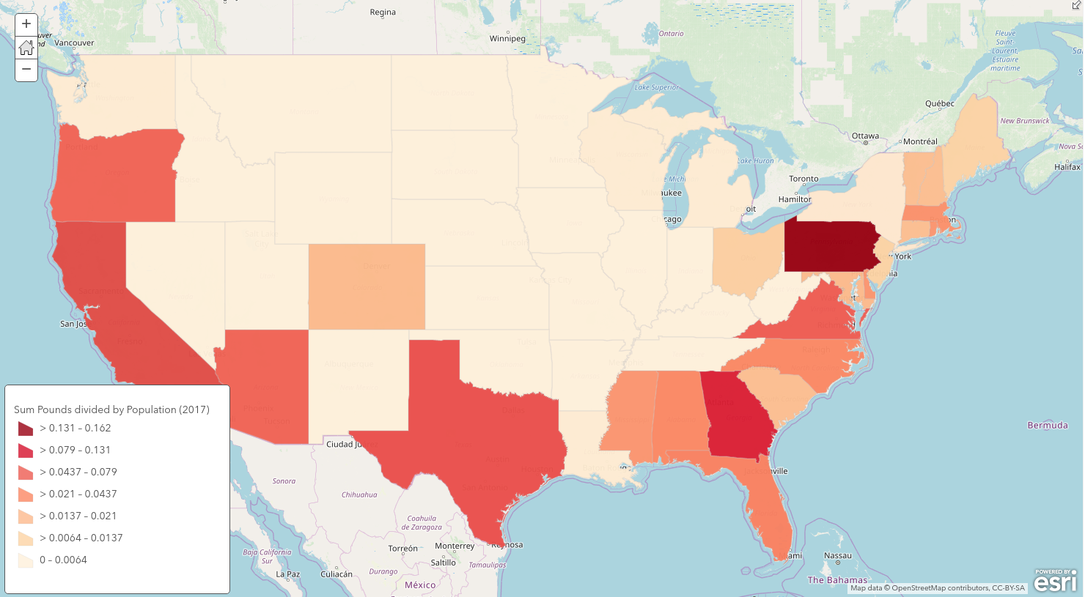
Garbage Volume Collected Per Capita

Slide 13
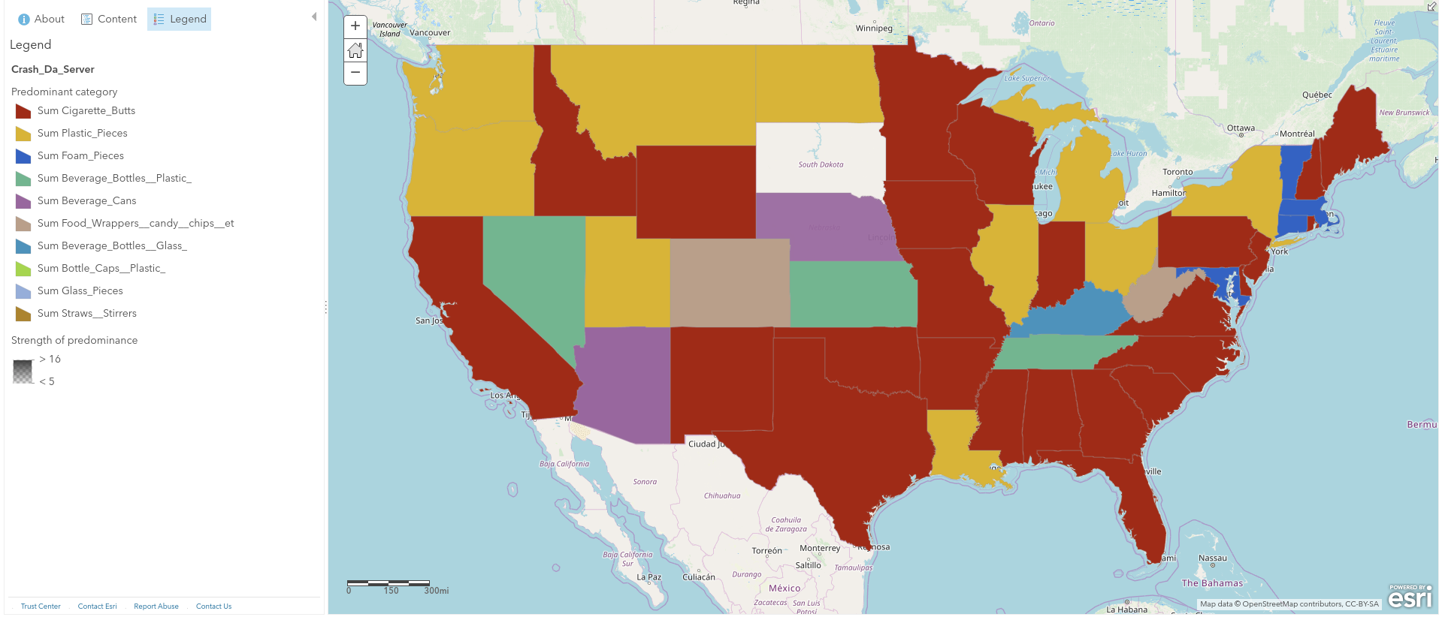
Most Common Trash Item for each State

Slide 14
Related Items (K-nearest Neighbors)
Cigarette Butts:
Food Wrappers (candy, chips, etc.)
Bottle Caps (Plastic)
Beverage Bottles (Plastic)
Glass Pieces
Straws, Stirrers
Bottle Caps (Metal)
Beverage Bottles (Glass)
Take Out/Away Containers (Foam):
Cups, Plates (Foam)
Cups, Plates (Plastic)
Cups, Plates (Paper)
Tobacco Packaging/Wrap
Paper Bags
Construction Materials
Forks, Knives, Spoons
Fishing Net & Pieces:
Fishing Buoys, Pots & Traps
Cigarette Lighters
Condoms
Appliances (refrigerators, washers, etc.)
Syringes
Diapers
Personal Hygiene (Clean Swell)
Tampons/Tampon Applicators:
Syringes
Condoms
Appliances (refrigerators, washers, etc.)
Cigarette Lighters
Diapers
Personal Hygiene (Clean Swell)
Toys

Slide 15
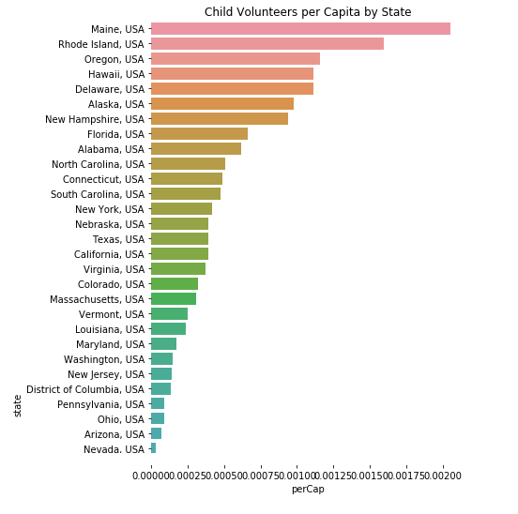
Education/Outreach
Maine, Rhode Island, Oregon, Hawaii, Delaware, Alaska and New Hampshire are the leading states in getting children involved in these Cleanup activities.

